Slide 1
1863: Los Tiempos Cambian

Slide 2
Los Tiempos Cambian
Date | Battle Name | Winner
Sept 17, 1862 | Antietam a.k.a. Sharpsburg, MD
April 12-13, 1861 | Attack on Fort Sumter, SC
April 30-May 6, 1863 | Chancellorsville, VA
Feb 6-16 ,1862 | Fort Henry/Fort Donelson, TN
Dec 13, 1862 | Fredericksburg, VA
July 1-3, 1863 | Gettysburg, PA
March-June, 1862 | Jackson’s Valley Campaign, VA
July 21, 1861 | First Manassas a.k.a. Bull Run, VA
August 28-30, 1862 | Second Manassas a.k.a. Second Bull Run, VA
Oct 8, 1862 | Perryville, KY
April 6-7, 1862 | Shiloh a.k.a. Pittsburg Landing, TN
May 18 – July 4 1863 | Siege of Vicksburg, MS
Dec 31, 1862-Jan 2, 1863 | Stones River a.k.a. Murfreesboro, TN
En la parte de arriba de tu línea de tiempo y mapa hay una grafica con la lista de las batallas incluyendo su localización y fecha.

Slide 3
First Manassas (Bull Run)
Notes:
Image information:
The ruins of Cub Run bridge after the battle, July 21, 1861.

Slide 4
Antietam (Sharpsburg)

Slide 5
Los Tiempos Cambian
Aunque habían mas victorias de la Unión en el oeste, muchas personas le ponían más importancia al este porque allí es donde estaban las capitales de los Estados Unidos y los Estados Confederados.

Slide 6
La Situación cuando el verano de 1863 llega
En el oeste, fuerzas militares bajo el mando de Ulysses S. Grant, han rodeado a Vicksburg, Mississippi, que era un punto significante porque controlaba el acceso al Rio Mississippi.

Slide 7
Vicksburg

Slide 8
Vicksburg
Después de 47 días de bombardeo, Pemberton se rindió a Vicksburg y a Grant el 4 de julio 1863.

Slide 9
La Situación cuando el verano de 1863 llega
En el este, las fuerzas Confederadas bajo el mando del General Robert E. Lee invadieron el estado norteño de Pennsylvania
Notes:
Image information:
View of Little Round Top, Gettysburg

Slide 10
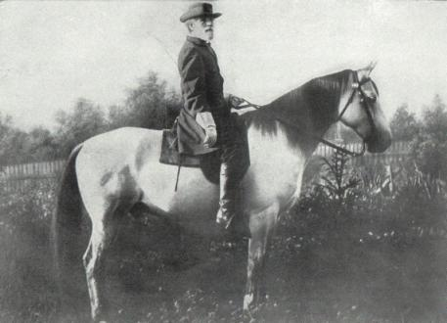
A este punto de la Guerra, el ejercito Confederado del Norte de Virginia tenía un record ganadores. Y el General de la Confederación, Robert E. Lee tenia un plan to mover tu ejercito al norte.
La Situación cuando el verano de 1863 llega
Notes:
Image information:
Robert E. Lee on Traveller

Slide 11
Gettysburg

Slide 12
Gettysburg
5 razones que Lee invadio a Pennsylvania :
to disrupt the Union’s ability to attack the Confederate capital at Richmond, Virginia
to draw the United States Army away from the safety of the defenses of Washington, D.C. and fight them in the “open”
to take the war away from the farmers in Virginia who were having problems planting and harvesting crops, as both armies had been camping or fighting on their land for the previous two summers
to “live off the land” and collect supplies to take back to Virginia
to win a decisive victory on Northern soil in the hopes of bringing the Civil War to a close

Slide 13
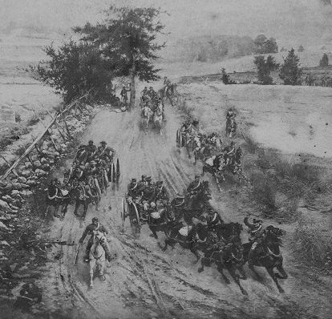
Gettysburg
El 1 de julio, 1863 la Union se encontro on el ejercito de Lee

Slide 14
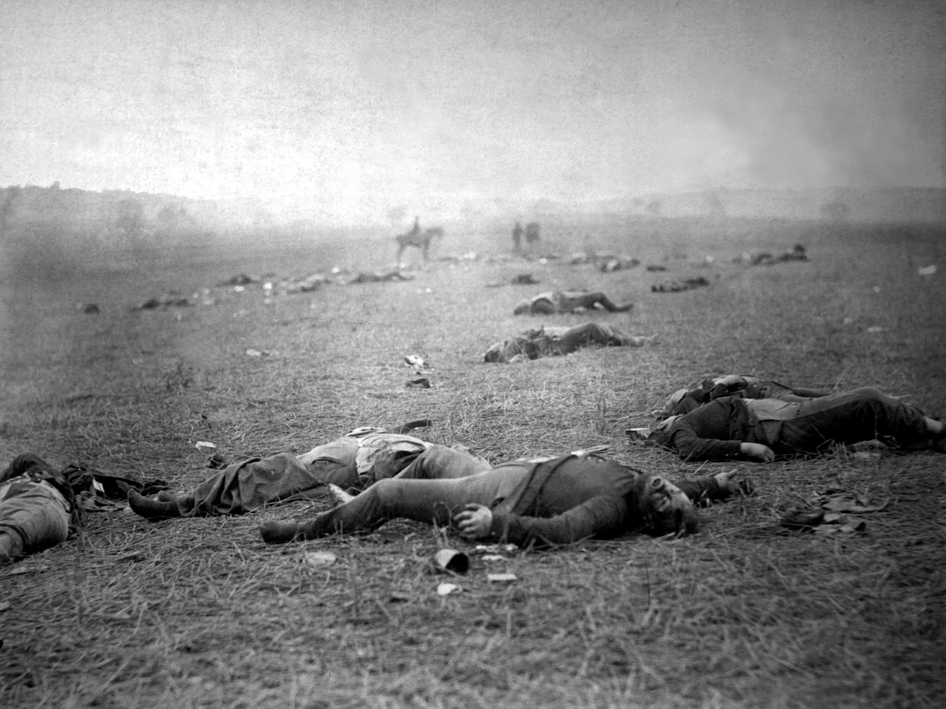
Después de tres días de luchar 1-3 de julio, 1863… Image courtesy Library of Congress

Slide 15
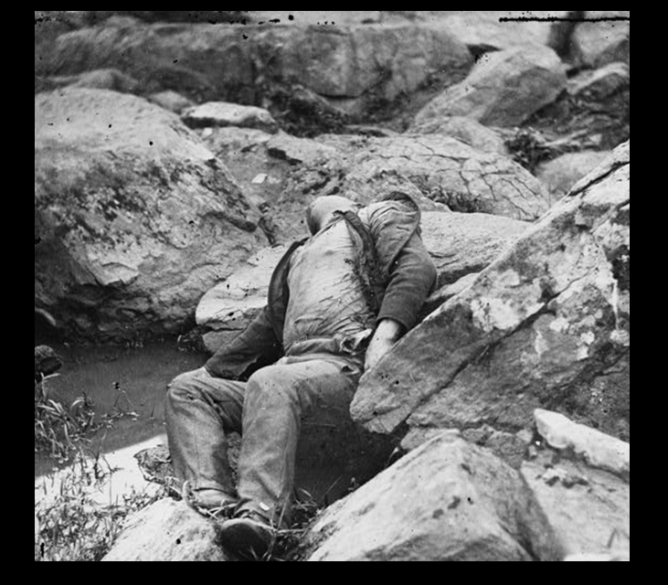
… y 51,000 soldados murieron, fueron heridos, o desaparecidos Image courtesy Library of Congress

Slide 16
Lee and his army left Pennsylvania and retreated back to Virginia. Never again would the Confederates invade a Northern state in large numbers.
Gettysburg
The Confederate Army of Northern Virginia was defeated

Slide 17
The Aftermath
In the United States
The victories at Gettysburg and Vicksburg increased the morale of the United States and its armies. Many people now felt that the war might be won.
In the Confederate States
The losses at Vicksburg and Gettysburg decreased the morale of the Confederate States and its armies.
For most of the remainder of the war the Confederates would be fighting on the defensive.

Slide 18
The Aftermath
Back at Gettysburg, the dead were buried in quickly dug battlefield graves.

Slide 19
The Aftermath
Most of the Confederate dead were left on the field in their shallow graves for eight to ten years until southern charity groups had most of the bodies taken away to cemeteries in the South.

Slide 20
The Aftermath
On November 19, 1863, a Soldiers’ National Cemetery was established at Gettysburg for the Union dead.

Slide 21
The Aftermath
Music was played and speeches were made, but the most significant speech, lasting approximately two minutes, was made by President Abraham Lincoln.

