Slide 1
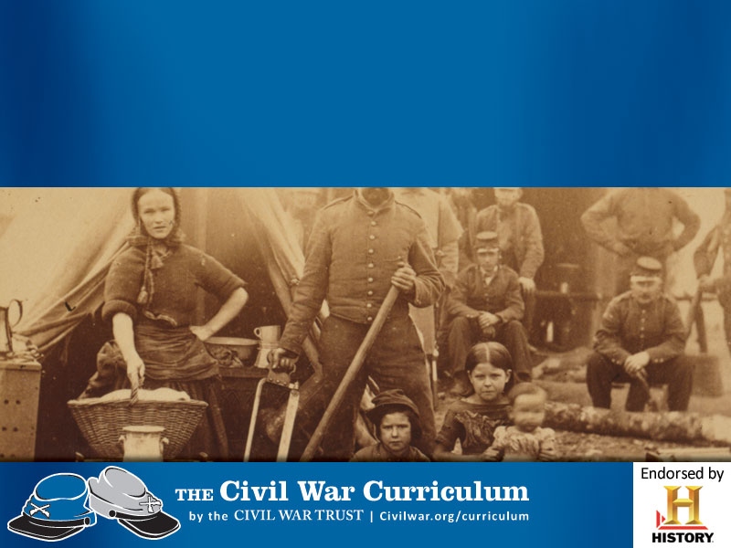
El Frente en Casa

Slide 2
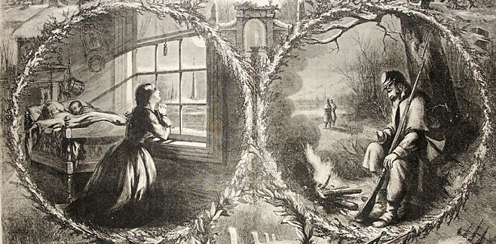
El Frente en Casa
La Guerra Civil tocó la vida de cada familia Americana, del norte al sur.
Notes:
Almost every family had a son, husband, sweetheart, brother or father away at war. For those who remained behind, the Civil War changed their lives forever.
Discussion Questions:
What does the kneeling woman symbolize?
What is the soldier doing?
Look at the pictures along the bottom of the slide. Describe the actions taking place.

Slide 3
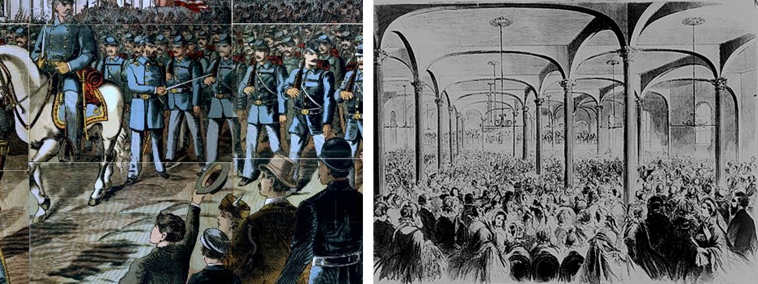
El Frente en Casa
Los hombres marchaban a la Guerra, dividiendo la nación.
Las mujeres se movilizaron para apoyar al ejercito.
Notes:
Picture on Left - Union soldiers and band march through a city in the woodcut “Off to the War.”
Picture on Right - Great meeting of the ladies of New York at the Cooper Institute, on Monday, April 29, 1861, to organize a society to be called "Women's Central Association of Relief," to make clothes, lint bandages, and to furnish nurses for the soldiers of the Northern Army

Slide 4
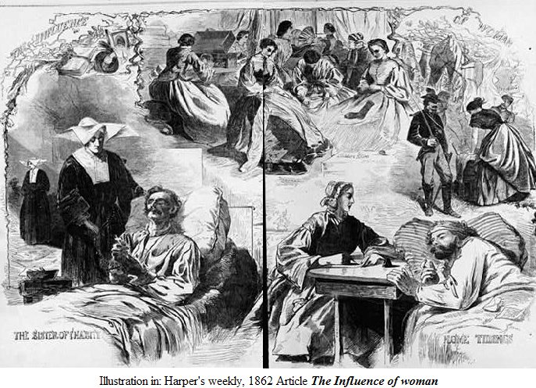
El Papel de la mujer
Notes:
Discussion Question:
What actions are women taking to support the soldiers in the picture?

Slide 5
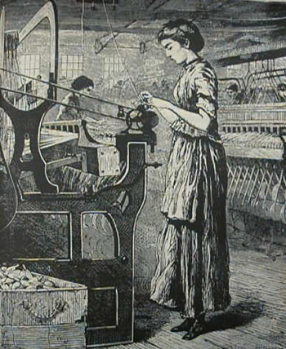
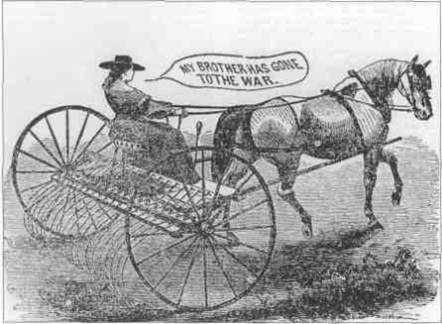
El Papel de la mujer
La vida debe continuar.
La mujeres toman los trabajos de los hombres.
Notes:
Notes for the Teacher: With so many men at war, women had to take on more responsibility. In the South, women on plantations took charge, serving as plantation mistresses and managing vast numbers of slaves while their husbands were away at war. Most Southern women took on the back-breaking strain of agricultural labor, often doing work that their husbands and sons would normally have done. In the North, women bore the brunt of manufacturing jobs or the farm work and were vital to the success of the war effort to supply the Union army.
Discussion Question:
What jobs did women take up when the men were called to war?

Slide 6
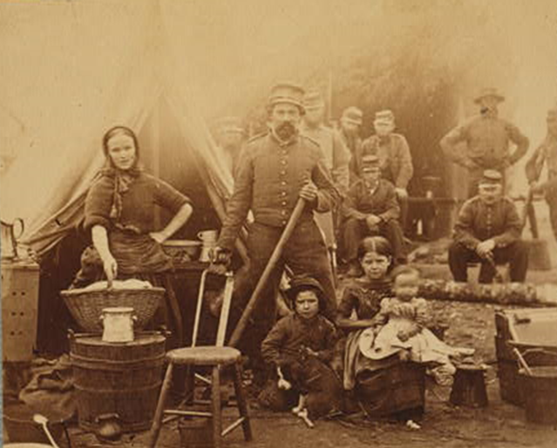
El Papel de la Familia
Algunas veces las familias seguían a los soldados al ejercito.
¿Como crees que era la vida para las familias?
Notes:
Discussion Question:
What do you think life was like for children in camp?

Slide 7
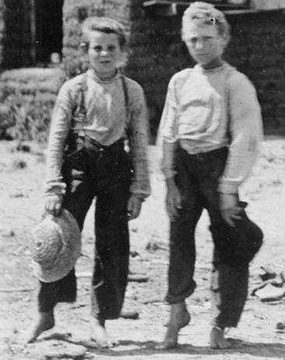
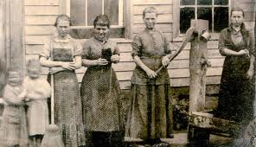
El Papel de la Familia
Los niños trabajaban en los campos mientras los padres o hermanos mayores iban a la Guerra.
Notes:
Children worked the fields for the family while their fathers and older brothers were away at war.
Discussion Question:
Why would the children have to work in the fields more?

Slide 8
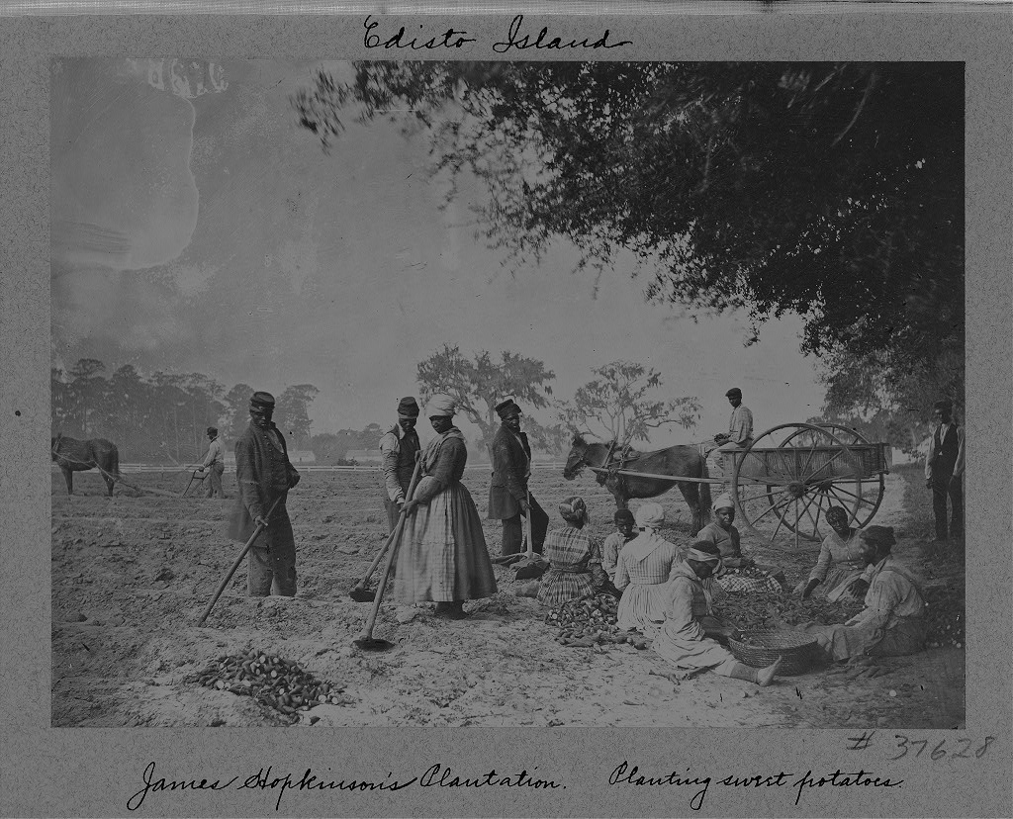
El papel de los esclavos
Notes:
In the South, some slaves continued to work for their masters and mistresses, providing for the troops and families for which they worked. However, many left, fleeing to the North in hopes of a better life.
Discussion:
What were two roles or tasks taken on by African Americans during the war?

Slide 9
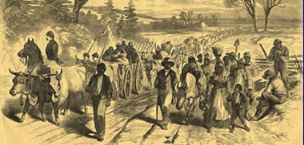
El papel de los esclavos
Notes:
Former slaves would travel North or with the army. Some former slaves joined the army while most others took care of their families and tried to find work.

Slide 10
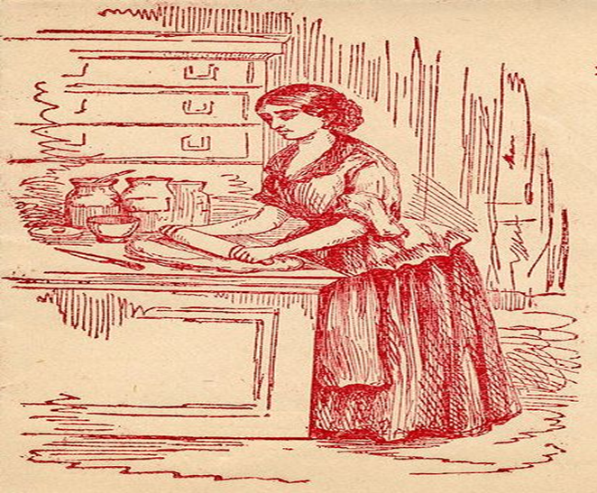
Challenging Times
Those on the home front had to meet the needs of their family as well as support the needs of the army.

Slide 11
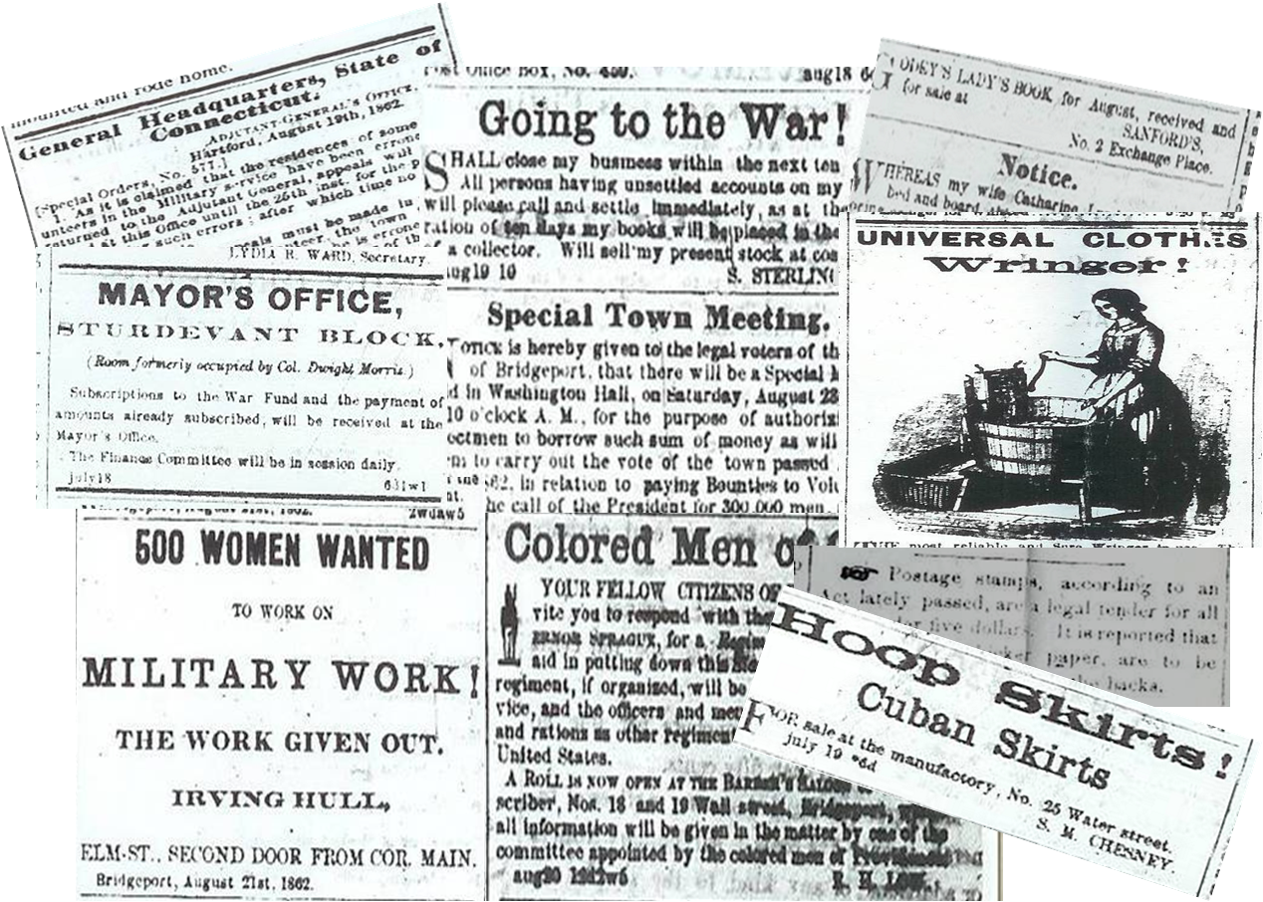
Information
Notes:
Information traveled at a slow rate in the 1800’s, but with the telegraph, newspapers, photography, and the postal service it was moving faster than ever before. Those on the home front were able to learn more about the war and their loved ones during the Civil War than in any previous war. Sometimes the reality of war was a brutal one.
Newspaper reading was at an all time high. Above are clips from a Connecticut newspaper from the summer of 1862.
The newspaper is where people on the home front received most of the news about the war.

Slide 12
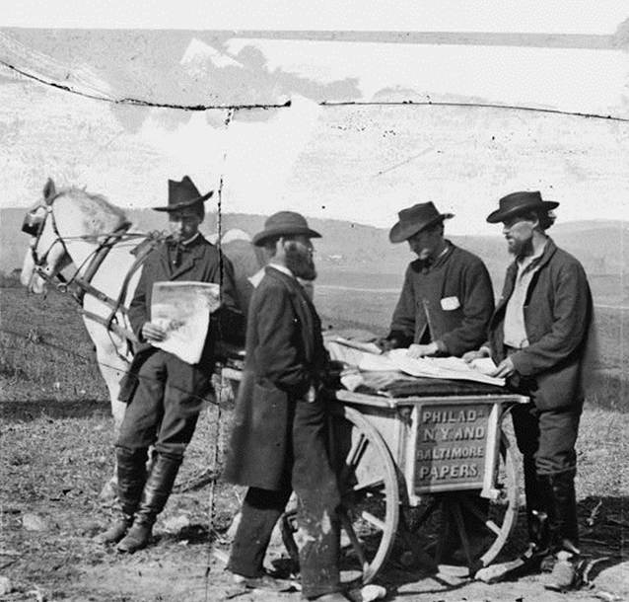
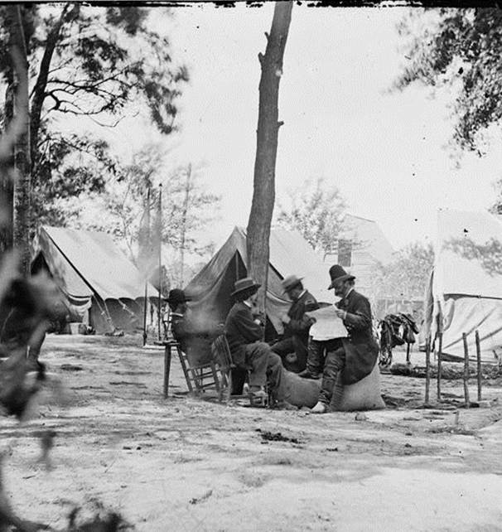
Information
Notes:
Newspaper reading reached an all-time high.
People scanned the newspapers every day for news of the war or their home.

Slide 13
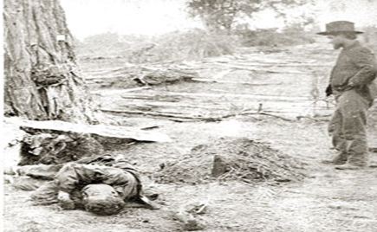
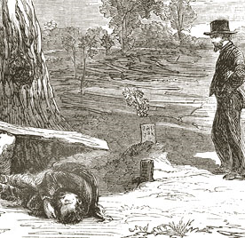
Information
Notes:
The American Civil War gave birth to photojournalism. The US government commissioned photographers to travel with the army and photograph the war. The images that returned home were vastly different from the glorious portrayal of war created by artists up until this time.
Alexander Gardner, working for Matthew Brady, shocked the nation with his photographs of dead on the Antietam Battlefield. Newspapers could not reproduce photographs at the time, but published woodcuts were viewed across the country.
Image Information:
On the Left - Gardner’s image entitled "A Contrast: Federal buried, Confederate unburied, where they fell on the Battlefield of Antietam.“
On the Right - Woodcut created from the Gardner photograph that was reproduced in the newspapers.
Notes for the Teacher: Gardner’s original images were put on display in New York City at Brady’s gallery. New Yorkers were shocked and appalled. For many Northerners it was the first time they saw the reality of war. The New York Times stated that with these images, Brady was able to "bring home to us the terrible reality and earnestness of war. If he has not brought bodies and laid them in our door-yards and along streets, he has done something very like it…“
Discussion Question:
How did photography change the way people saw the war?

