Slide 1
1864-1865: Terminando la guerra

Slide 2
Terminando la guerra
Notes:
At this point the situation is looking up for the United States with victories at Vicksburg and Gettysburg; but some people are tired of war and looking for a way to end it soon.
Lincoln has served four years as President, one term.
Discussion: How do you think the election is going to go? Do you think people will reelect Lincoln or go with someone else? While Lincoln believes that it is important to keep fighting to bring the Southern States back what do you think his opponent believes?

Slide 3
Elección de 1864
former Union General George B. McClellan
Y George H. Pendleton
Abraham Lincoln
Y Andrew Johnson
Notes:
With the war raging and the fate of the country hanging in the balance, the 1864 election had particular significance. Abraham Lincoln sought reelection in his campaign against former Union General George B. McClellan.
Image information:
Left – Democratic Candidates
Right – Republican Candidates

Slide 4
Elección de 1864
Abraham Lincoln su argumento era que necesitaban ganar la guerra, liberar a los esclavos, y la Unión debe ser preservada.
George McClellan su argumento era que la Guerra había tardado suficientemente y que el sur debe de ser permitido de suceder para que podamos salvar la vida de los Americanos. Esto significaba que la esclavitud seguiría en los estados Sureños.
Notes:
Abraham Lincoln argued that the war must be won, the slaves freed, and the Union preserved at all costs.
McClellan argued that the war had gone on long enough and that the South should be allowed to secede in order to save American lives. This meant that slavery would continue in the Southern states.

Slide 5
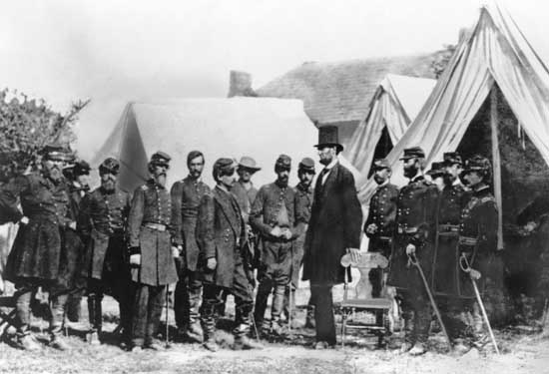
Elección de 1864
Abraham Lincoln ganó la elección y la guerra continuó

Slide 6
Terminando la guerra
Abraham Lincoln asignó a Ulysses S. Grant como comandante de todas las fuerzas armadas.
Image courtesy of the Library of Congress

Slide 7
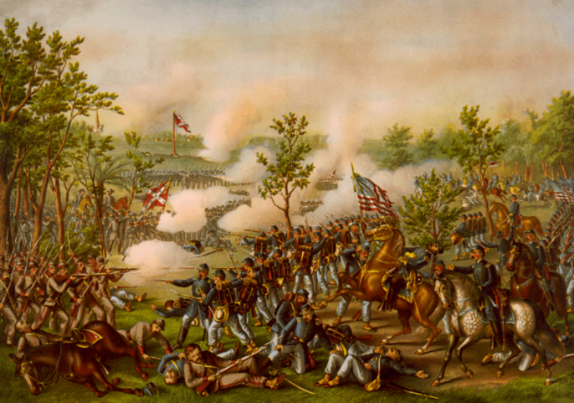
Terminando la guerra
Grant decidió luchar la Guerra en cinco frentes, con el mayor número en Richmond y Atlanta.
Notes:
Grant decided to fight the war on five fronts, with the biggest numbers toward Richmond and Atlanta.

Slide 8
Confederate Surrender
Los ejércitos de la Unión pudieron coordinar y Lee se rindió en Appomattox, Virginia el 9 de april, 1865.
Encuentra Appomattox en tu mapa y escribe, Rendición de los Confederados.
Image courtesy of the National Park Service

Slide 9
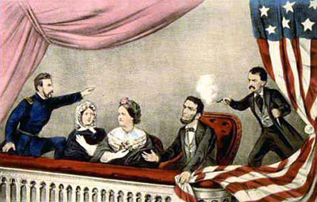
Lincoln assessinado
14 de abril de 1865 en Washington D. C.
5 días después del fin de la guerra

Slide 10
Confederate Surrender
“With an increasing admiration of your constancy and devotion to your country, and a grateful remembrance of your kind and generous consideration for myself, I bid you all an affectionate farewell”
- Robert E. Lee

Slide 11
Confederate Surrender
“…not a sound of trumpet more, nor roll of drum; not a cheer, nor word, nor whisper of vain-glorying, nor motion of man standing again at the order, but an awed stillness rather, and breath-holding, as if it were the passing of the dead.” -Joshua Lawrence Chamberlain
Notes:
Discussion:
Based on the quote from Lee, quote from Chamberlain, and the Articles of Agreement, how do you think the US forces felt about the Confederate forces at the end of the war?

Slide 12
Johnston Surrenders to Sherman
Johnston se rindió a Sherman el 26 de abril, 1865 en la casa de James Bennett cerca de Durham, North Carolina.

Slide 13
Rebuilding
Después del rendimiento, la meta era de construir y reunificar al país.
Image courtesy of the National Archives
Notes:
Image information:
Richmond in ruins.

Slide 14
Línea de Tiempo y Mapa
Actividad
Haz una línea de tiempo de los eventos que causaron que se termine la Guerra.
En el mapa, escribe los nombres de las batallas y la fecha cuando ocurrió.

